Slide 1
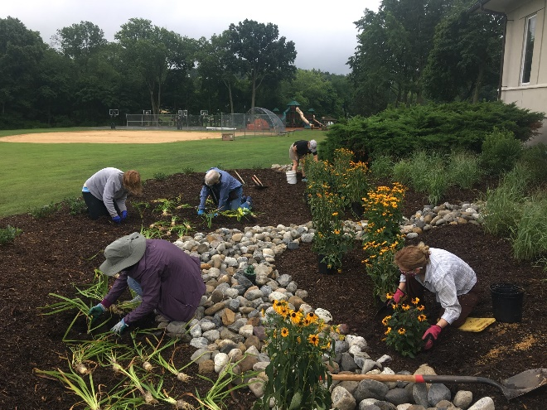
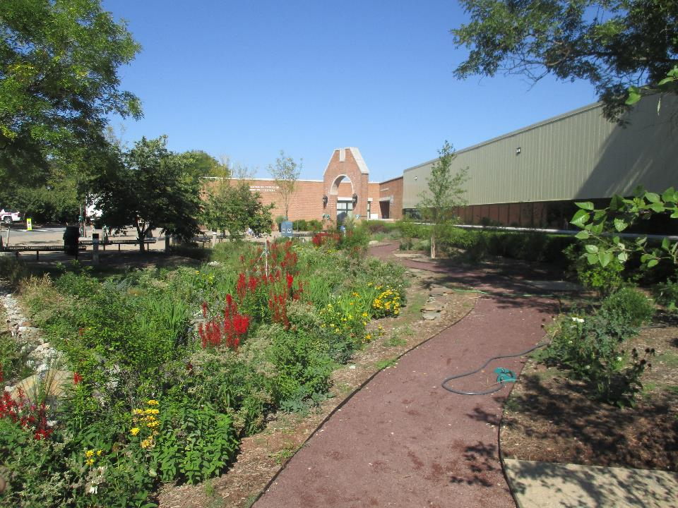
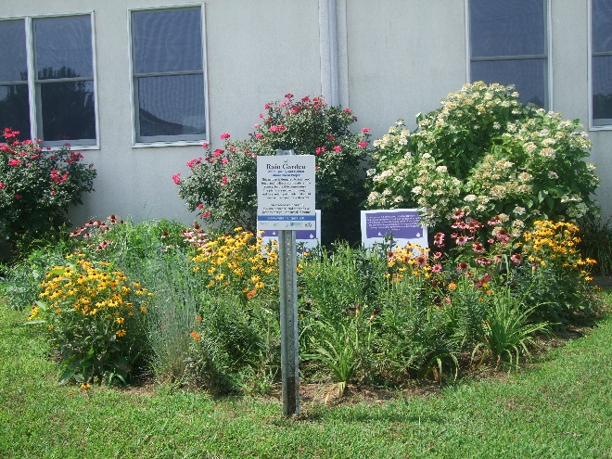
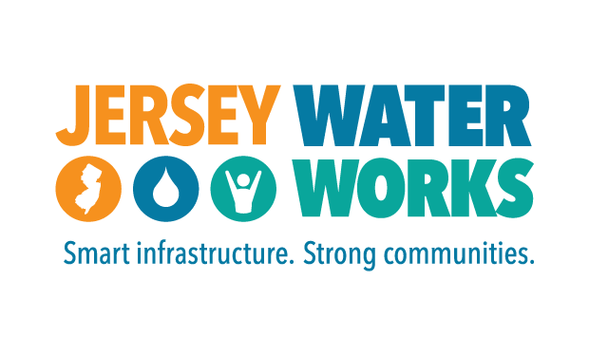



Green Infrastructure Overview

Slide 2
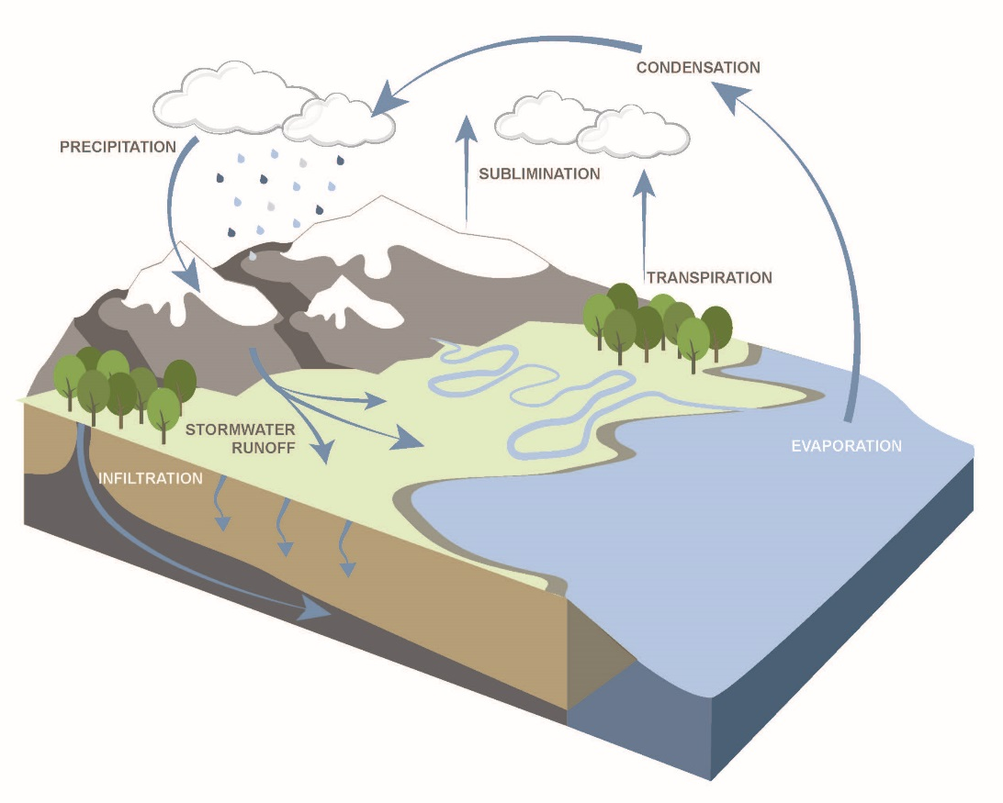
The Natural Water Cycle
Notes:
This is the Natural Water Cycle. When it rains, precipitation can be absorbed by plants, is used for photosynthesis and other biological processes. It can infiltrate through the soil surface and percolate downward to recharge groundwater aquifers. It can evaporate. Or it can run off and become stormwater.
But this cycle doesn’t represent all of the 7,354 square miles of land in New Jersey. 12.1% of the land in New Jersey is covered with impervious surfaces.

Slide 3
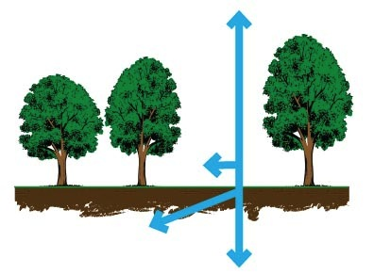
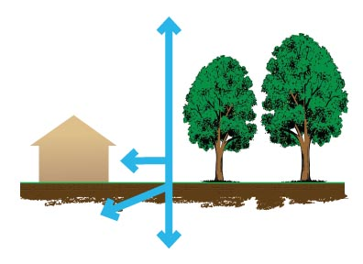
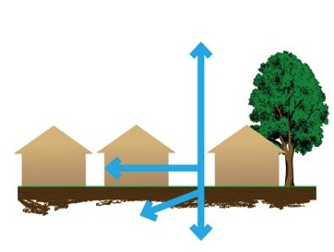
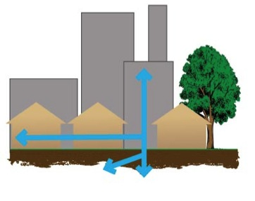
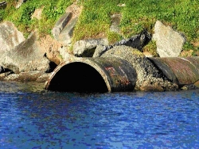
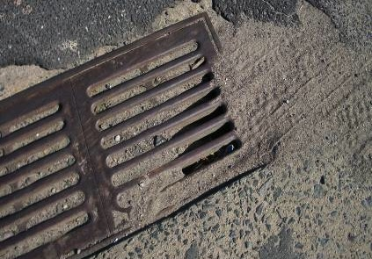
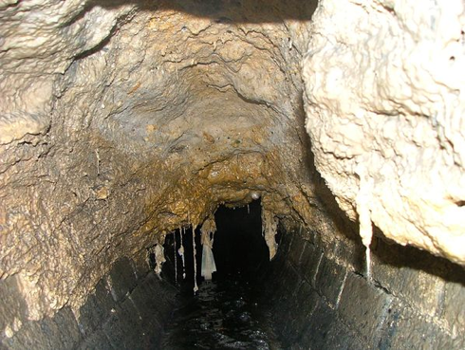
Impervious Surfaces
30%
55%
10%
20%
More development
More impervious surfaces
More stormwater runoff
Notes:
As we develop our landscape, we add impervious surfaces, thereby converting the natural water cycle into …

Slide 4
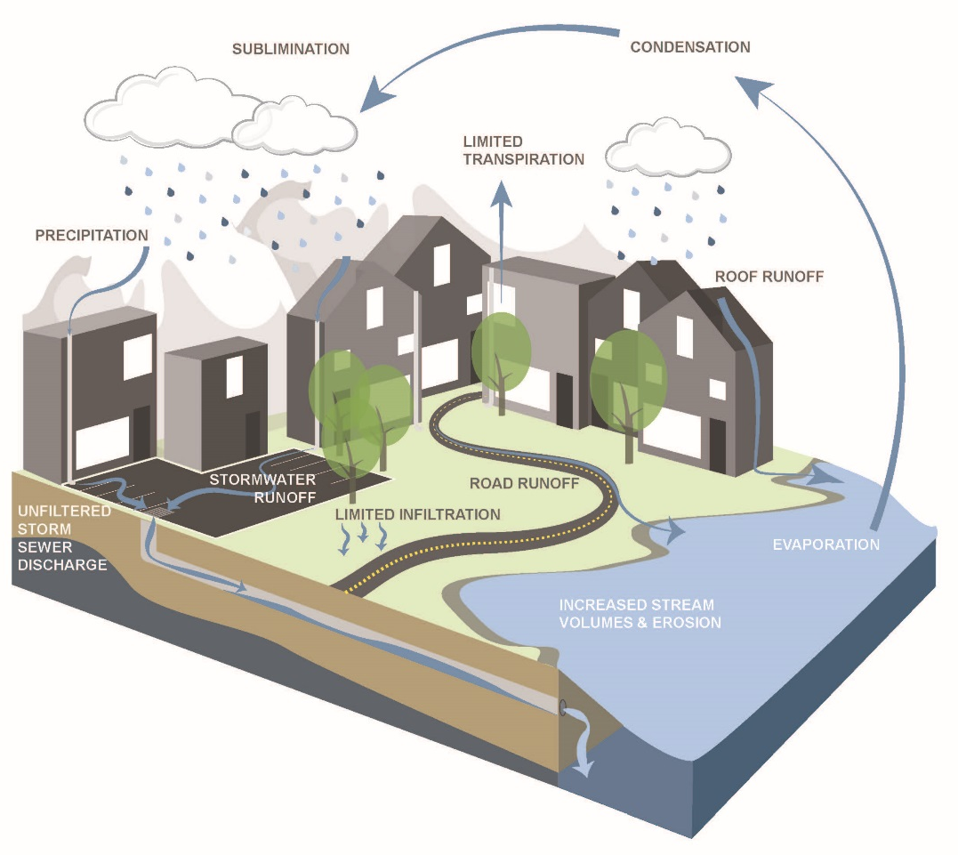
The Urban Water Cycle
Notes:
urban water cycle. In New Jersey, we now have much less infiltration and transpiration and much more runoff. One goal of stormwater management with green infrastructure is to restore the urban water cycle back into the natural water cycle by reducing runoff and increasing infiltration.

Slide 5
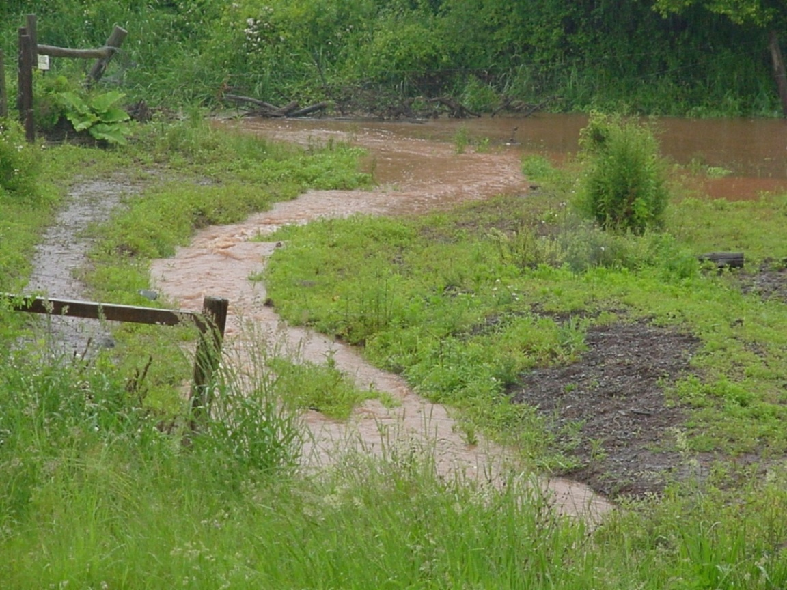
What is stormwater?
Stormwater is the water from rain or melting snows that can become “runoff,” flowing over the ground surface and returning to lakes and streams.
Notes:
Stormwater runoff is the main cause of New Jersey’s waterways being impaired.

Slide 6
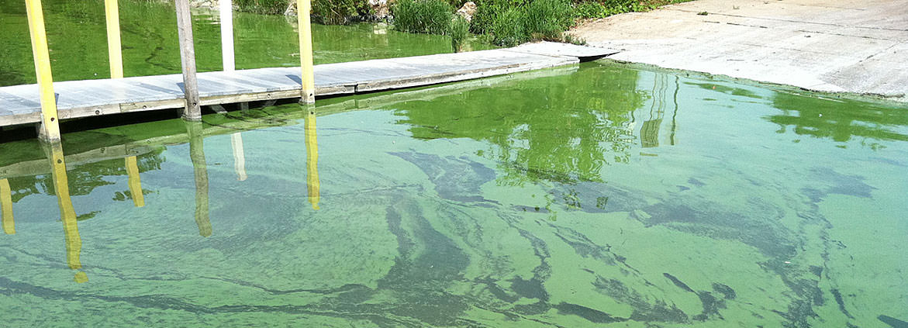
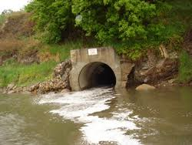
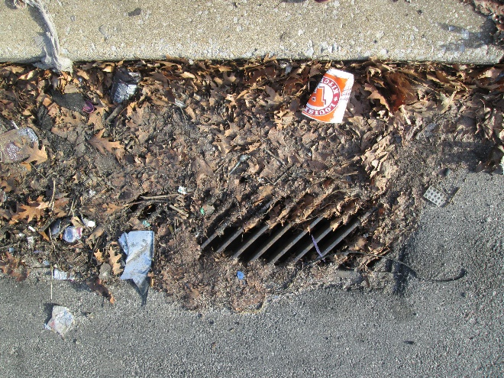
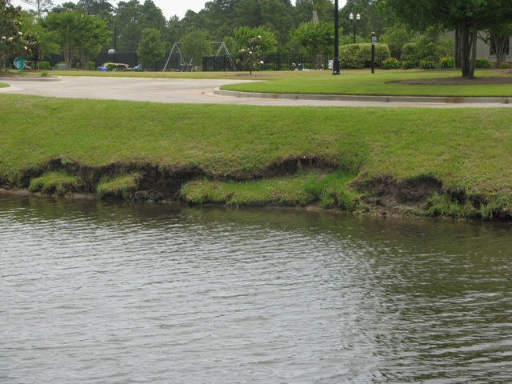
Water Quality
Notes:
Stormwater runoff can impact water quality, fish kills, harmful algal blooms, high bacteria levels, etc.

Slide 7
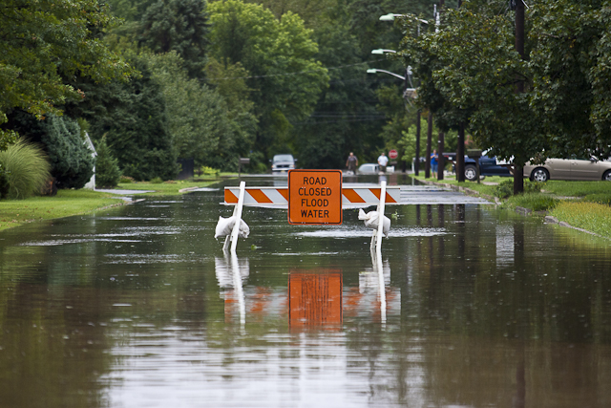
Water Quantity (flooding)
Notes:
Stormwater runoff can cause localized flooding.

Slide 8
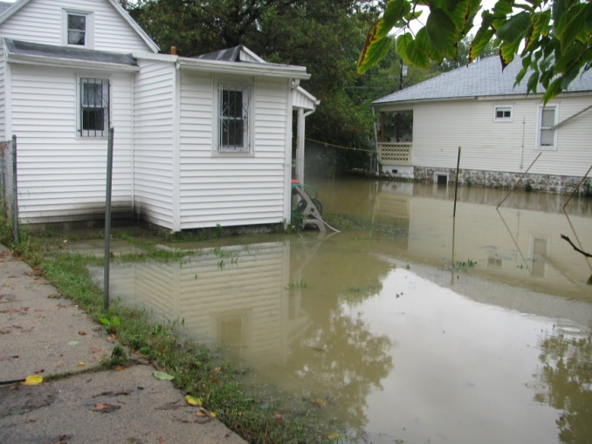
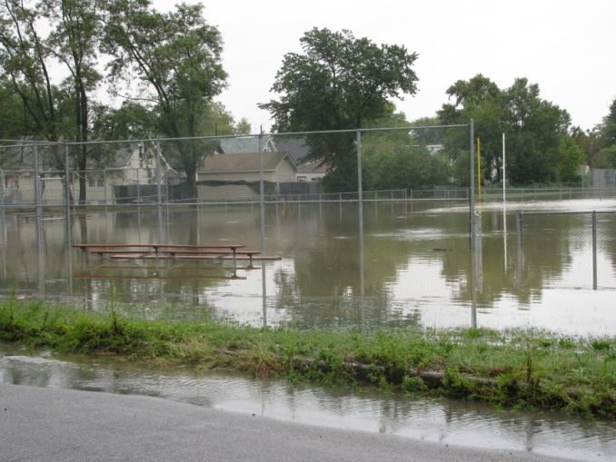
More Flooding
Notes:
Flooding of our urban and suburban communities

Slide 9
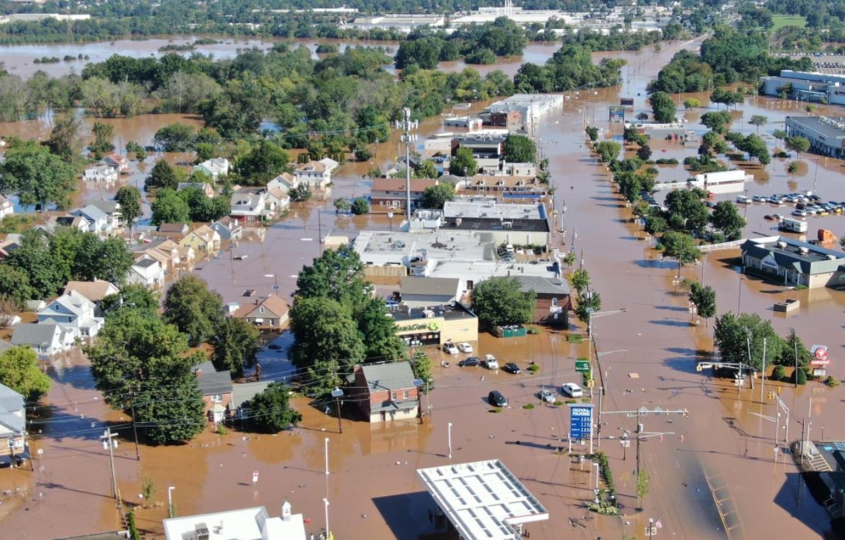
And even more flooding
Notes:
And of course, major flooding of our cities and towns.

Slide 10
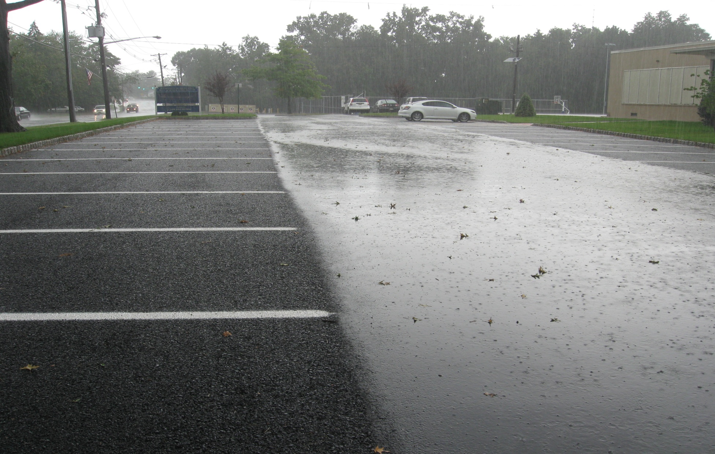
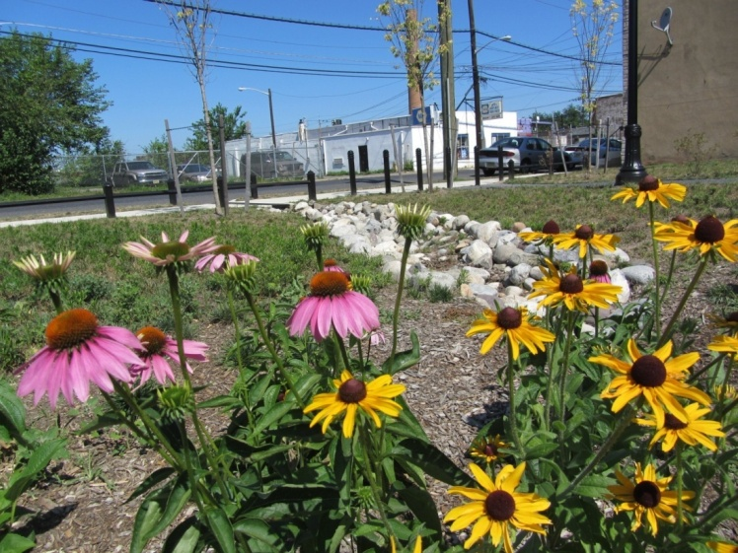
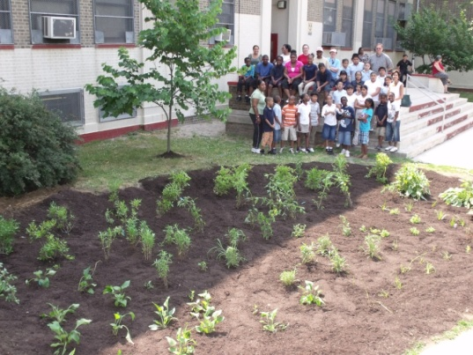
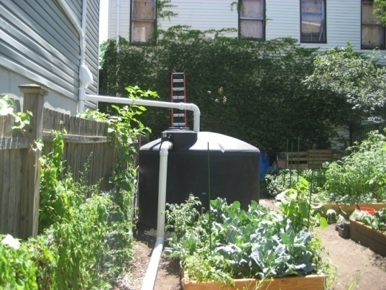
Is Green Infrastructure a solution?
…an approach to stormwater management that is cost-effective, sustainable, and environmentally friendly.
Green Infrastructure projects:
  capture,
  filter,
  absorb, and
  reuse
stormwater to maintain or mimic natural systems and treat runoff as a resource.
Notes:
We are here to talk about green infrastructure planning and implementation. What is green infrastructure? … an approach to stormwater management (blah, blah, blah) read the slide

Slide 11
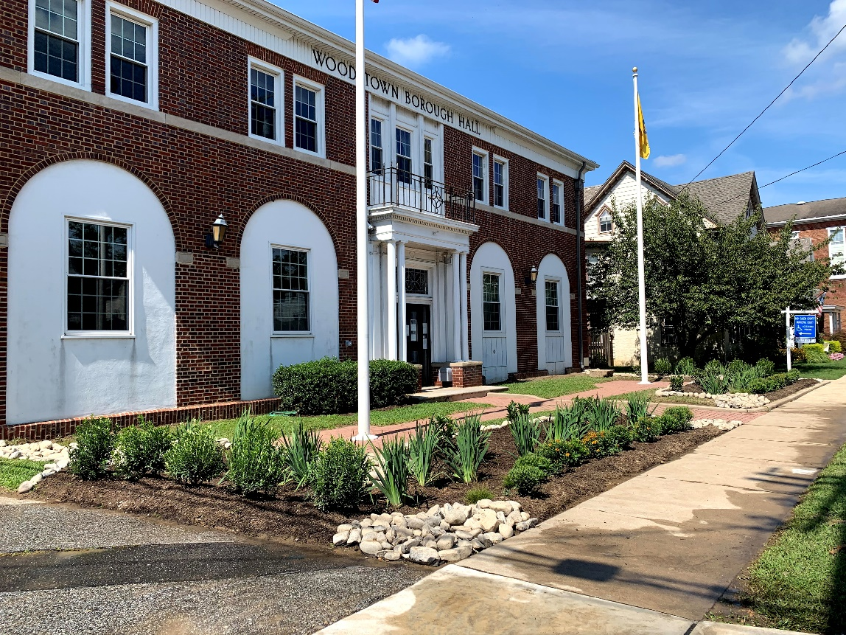
Green Infrastructure
Stormwater management practices that protect, restore, and mimic the native hydrologic condition by providing the following functions:
Infiltration
Filtration
Storage
Evaporation
Transpiration
Notes:
Green infrastructure practices helps restore the infiltration and evapotranspiration component of the water cycle and reduce the runoff component. GI practices provide one or more of these five functions.

Slide 12
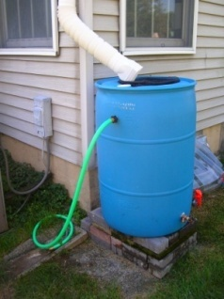
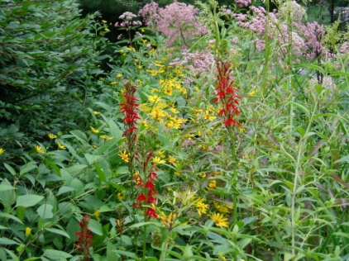
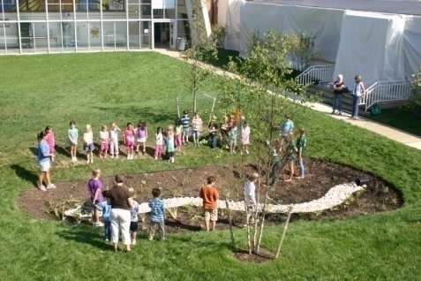
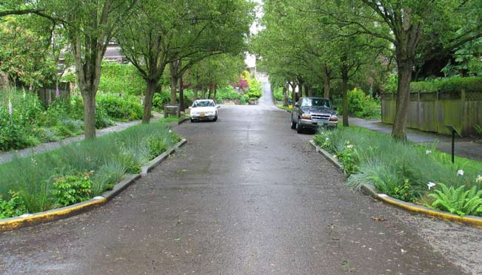
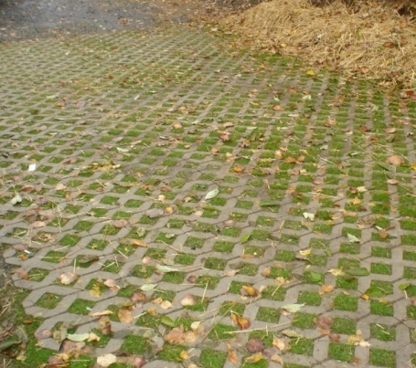
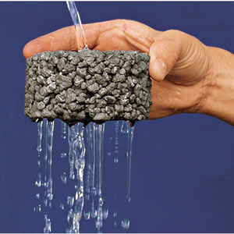
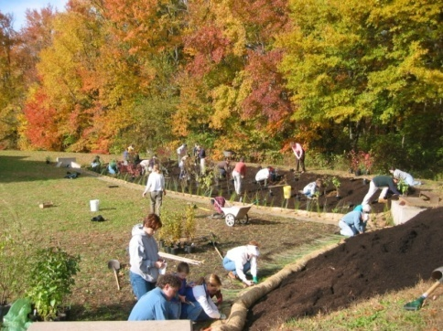
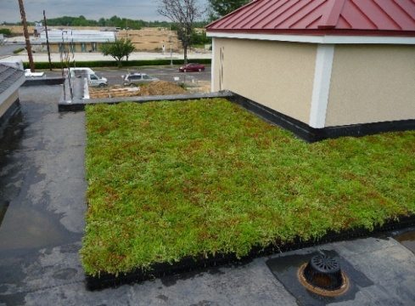
Green Infrastructure Practices
Bioretention Systems
Rain Gardens
Bioswales
Stormwater Planters
Curb Extensions
Tree Filter Boxes
Permeable Pavements
Rainwater Harvesting
Rain barrels
Cisterns
Dry Wells
Rooftop Systems
Green Roofs
Blue Roofs
Parker Urban Greenscapes. 2009.
Notes:
Most green infrastructure practices are designed to improve water quality, namely, to capture the first 1” of stormwater runoff, known as the first flush. During a storm event, a majority of the pollution washes off the land in the first 20 minutes. So, if you can capture and treat this first flush, we can go a long way to improving water quality and maybe eliminate some localize flooding from smaller storms but what about the infamous 100-Year storm?

Slide 13
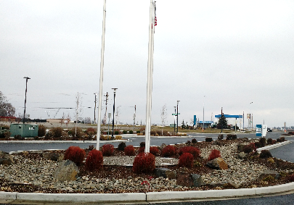
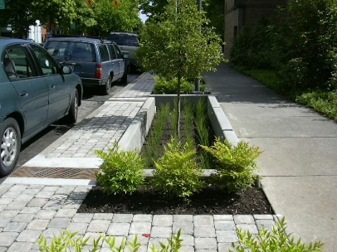
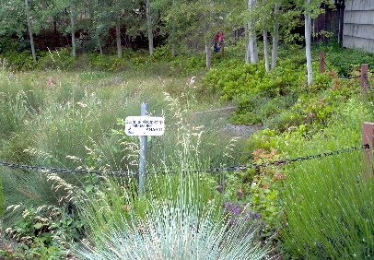
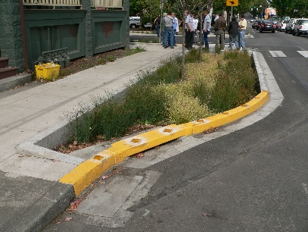
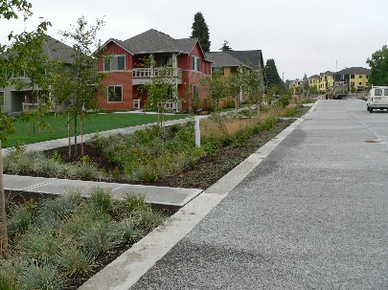
TYPES OF BIORETENTION
Larger Bioretention Systems
  Single-family lots
  Commercial areas
  Parking lots
Planters & Planter Boxes
  Highly urban areas
  Right-of-way and adjacent to buildings
Rain Gardens
  Single-family lots
  Small commercial areas
Bioretention Swales/ Bioswales/Vegetated Swales
Typically in right-of-way
Vegetated Curb Extensions
  Bioretention incorporated into right-of-way in urban and suburban areas
Notes:
First let’s talk about some of these practices. Bioretention is one of the best practices. Very effective, lower cost, lots of ancillary benefits ( enhanced aesthetics, sequesters carbon, provide pollinator habitat). We often design these practices to capture, treat, and infiltration up to the 2-years storm, which is about 3.3 inches of rain over 24 hours.

Slide 14
Rain Gardens
Notes:
Bioretention systems are landscaped shallow depressions that are designed to capture, treat and infiltrate stormwater runoff at the source before it can get into the sewer system or the local waterway. These are often called rain gardens. Advantages of bioretention systems include . . .

Slide 15
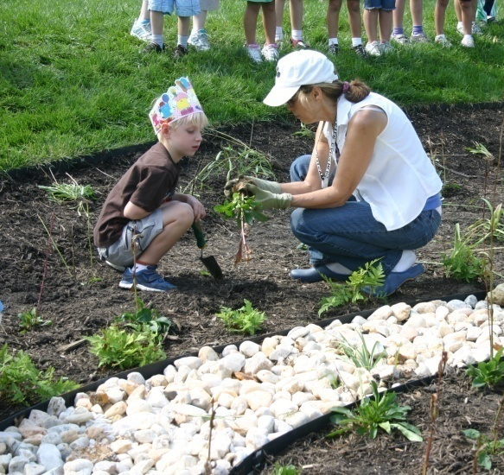
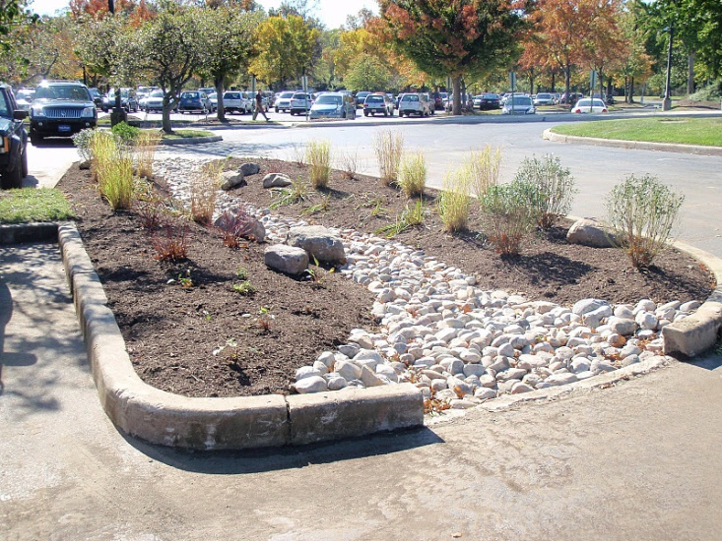
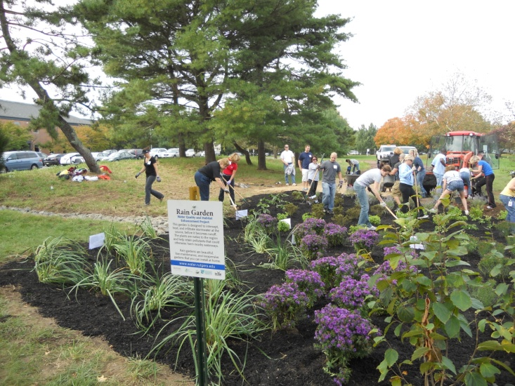
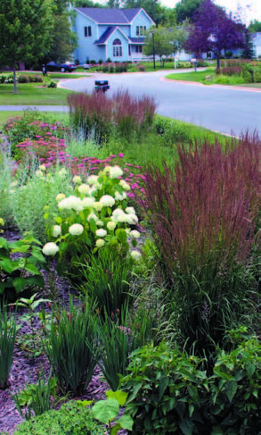

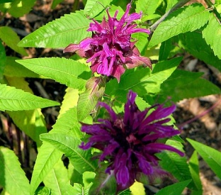
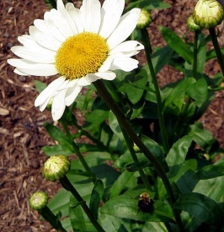
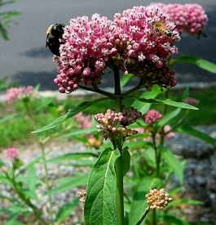
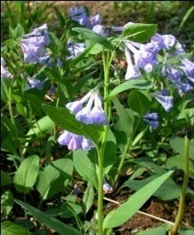
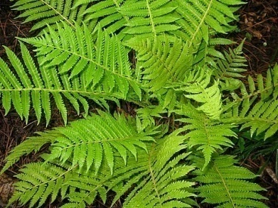
Lots of Rain Gardens
Notes:
First there are lots of type of rain gardens.

Slide 16
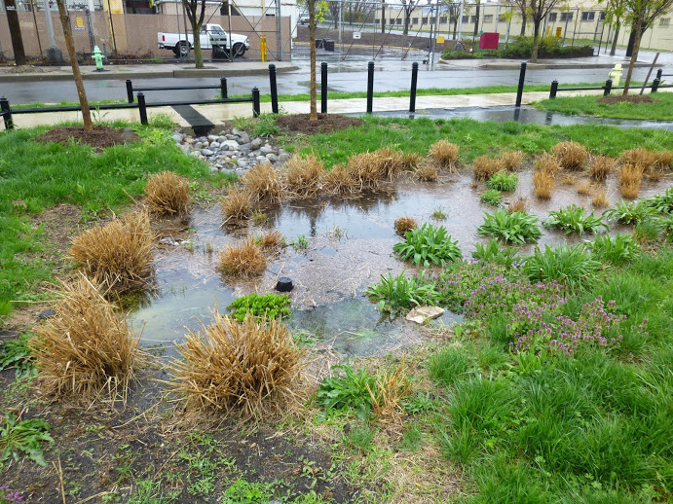
Notes:
Rain garden provide very high pollutant removal efficiencies. This is a rain garden in Camden that takes stormwater runoff from the surrounding roadways. A trench drain was installed in the sidewalk to convey the runoff from the road into the garden.

Slide 17

Notes:
Rain gardens provide wildlife habitat, especially pollinator habitat. Some have suggested we start calling rain gardens: “Pollinator Rain Gardens.”

Slide 18

Notes:
Rain garden are often more aesthetically pleasing than conventional detention basins. This rain garden used the existing storm drain as an overflow. When the garden fills with 6” of runoff, it will sit in the garden until it seeps into the ground. Any runoff over 6” will go into the existing storm drain and be carried away in the storm sewer system. Since the rain garden is design to capture the NJ Water Quality Storm (1.25” of rain over two-hours) and 90% of NJ’s rainfall comes in storms less than 1.25”, this rain garden will capture, treat, and infiltrate the stormwater runoff from 90% of the rainfall events.

Slide 19

Notes:
Rain gardens can be easily incorporated into the landscapes of individual homes

Slide 20

Permeable Pavement
Notes:
Another one of my favorite practices is permeable pavement.

Slide 21




Permeable Pavements
Underlying stone reservoir
Porous asphalt and pervious concrete are manufactured without "fine" materials to allow infiltration
Grass pavers are concrete interlocking blocks with open areas to allow grass to grow
Permeable pavers systems are concrete pavers with infiltration between the spaces of the pavers
Ideal application for porous pavement is to treat a low traffic or overflow parking area
Notes:
Four main types of permeable pavements: porous asphalt, pervious concrete, permeable pavers, and grass (reinforced turf) pavers.

Slide 22

ADVANTAGES
COMPONENTS
Manage stormwater runoff
Minimize site disturbance
Promote groundwater recharge
Low life cycle costs, alternative to costly traditional stormwater management methods
Mitigation of urban heat island effect
Contaminant removal as water moves through layers of system
Notes:
And no black ice

Slide 23
Porous Asphalt
Notes:
Porous asphalt parking lot at the Clark municipal building. Porous asphalt in the parking spaces and traditional asphalt in the cartway.

Slide 24


Pervious Concrete
Notes:
Pervious concrete

Slide 25

Permeable Pavers
Notes:
Permeable pavers

Slide 26

Grass Pavers
Notes:
Grass pavers (this one is called turfstone)

Slide 27

Rainwater Harvesting Systems
Notes:
Rainwater harvesting is another green infrastructure practice that can be used throughout New Jersey

Slide 28









Rain Barrels
Notes:
There are rain barrels that the individual homeowner use.

Slide 29




Cisterns
Notes:
Cisterns are bigger rainwater harvesting systems

Slide 30

Notes:
The benefits of rainwater harvesting systems are: they provide access to free water

Slide 31

Notes:
Are sometimes the only source of water for community gardens

Slide 32

Notes:
Are easily winterized

Slide 33

Let’s get back to flooding – bioretention is an option but does it take up too much space?
Notes:
What about flooding? How can GI be used to address flooding from bigger storms? This is the bioretention basin at the Frelinghuysen Arboretum. It captures stormwater runoff from the parking lot and the buildings.
.

Slide 34

Notes:
This is one that was built at an office building in Readington. When it rains, these systems fill up with six inches of water that is allowed to infiltrate and the stormwater runoff from larger storms fills up the remaining 4 feet of basin and is slowly released over time. Now both of these larger bioretention basins were built as part of new construction but how do we go into developed areas and retrofit them with this level of stormwater management. Is bioretention still an option?

Slide 35

Notes:
This was a retrofit project but only designed to capture the first 1.25 inches of stormwater runoff from the parking lot. If we wanted to manage the 100-year storm we would have to make it 6.5 times deeper or about 3.25 feet deep. But this would only manage runoff from the parking lot not the surrounding buildings like the bioretention system at the Arboretum and Office Building does.

Slide 36



Notes:
We could leave the rain garden as is and install overflow drains in it as shown in this picture. Then these drains could carry the stormwater runoff from larger events to a storage/infiltration system under the parking lot. Only 20 to 25% of the area under the parking lot would be needed to manage runoff from the parking lot, leaving additional space for managing the stormwater runoff from the surrounding buildings or streets.

Slide 37
Notes:
Or we could just make the parking lot into permeable pavement and increase the stone storage reservoir under the parking lot. The porosity of the stone is 40% so for every foot of water you want to manage, you need 2.5 feet of stone. There is a porous asphalt parking lot at a Target/Lowes in Vermont with 8 feet stone storage layer.

Slide 38
What if …
every time we repave a parking lot in New Jersey, we convert it into a stormwater management system. For every acre of parking lot, we can capture stormwater runoff from the 100-year storm from four to five acres of impervious surfaces. When we include a rain garden, we can further increase the benefits.

Slide 39


In the meantime, do your part and install a rain garden.

Slide 40

Questions?

